Slide 1
Introduction to Bayesian Inference
Rebekah Gelpí & William Ai
Early Cognition Lab
Department of Psychology, University of Toronto
Notes:
Hey everyone, my name is William and I’m with Rebekah today to introduce to you the basics of Bayesian inference. For the first half of this workshop, you will be familiarized with Bayesian thinking, its components, as well as how it’s different from traditional significance testing. For the second half, Rebekah will walk you through how Bayesian hypothesis testing can be conducted.

Slide 2
What is Bayesian Inference?
Bayesian inference = updating the probability of a hypothesis as we discover more evidence and information¹
Prior Beliefs/Information
Collect Evidence
Update Beliefs
¹Zyphur & Oswald (2015)
Notes:
So to begin, Bayesian inference is the process of updating the probability of a hypothesis as we discover more evidence and information. In simpler terms, you can think of it as a cycle of updating beliefs as you gain more facts and knowledge about the world, which is something we do everyday.

Slide 3
Bayes’ Theorem
Likelihood
Prior
Posterior
$$P\left(θ | D\right)=\frac{P\left(D | θ\right)P(θ)}{P(D)}$$
Normalization term
Notes:
This is the Bayes theorem, which outlines all the components that we need. So first you need your prior belief about the probability of a hypothesis, and the likelihood of the data, as well as a normalization term to frame the output as a probability within 0 to 1. Finally, there’s the posterior, which represents your updated belief. Essentially, the theorem is a mathematical model that gives us a way to integrate all the information we need in order to update our beliefs, and it’s been shown repeatedly in research as the optimal way to assess real-world uncertainty.

Slide 4
Understanding check
We decide that something (the data, or the hypothesis) is totally impossible and has probability 0. What’s the problem with this in relation to Bayes theorem?

Slide 5
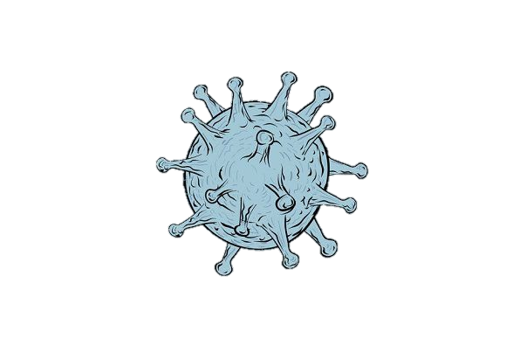
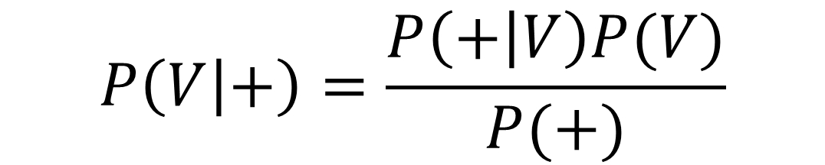
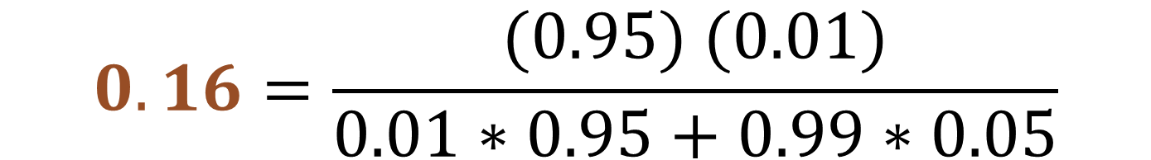
Bayesian Application
A new test for a virus is 95% accurate
If I test positive, does that mean I have a 95% chance of having the virus?
Probability of testing positive given that you have the virus
Proportion of entire population who has the virus (~1%)
Probability of having the virus given that you tested positive
$$0.16=\frac{(0.95) (0.01)}{0.01∗0.95+0.99∗0.05}$$
$$P\left(V | +\right)=\frac{P\left(+ | V\right)P(V)}{P(+)}$$
Notes:
This is a very simple example to demonstrate how Bayesian thinking can be applied to the real world. So, say if you were told that a new test for a virus is 95% accurate, you might wonder, if I then test positive, does that mean I have a 95% chance of having the virus?
So let's use Bayes’ theorem to figure it out. First, you plug in your prior knowledge, which is the proportion of the entire population who has the virus. Let’s assume it’s about 1%. Then, we put in the likelihood, which is the probability of testing positive given you have the virus. After normalizing it, you get the posterior, which is what we’re interested in. Once you plug in the numbers, the theorem tells us that given I tested positive, there’s only a 16% chance that I actually have the virus. That is much lower than what we originally thought, right?

Slide 6
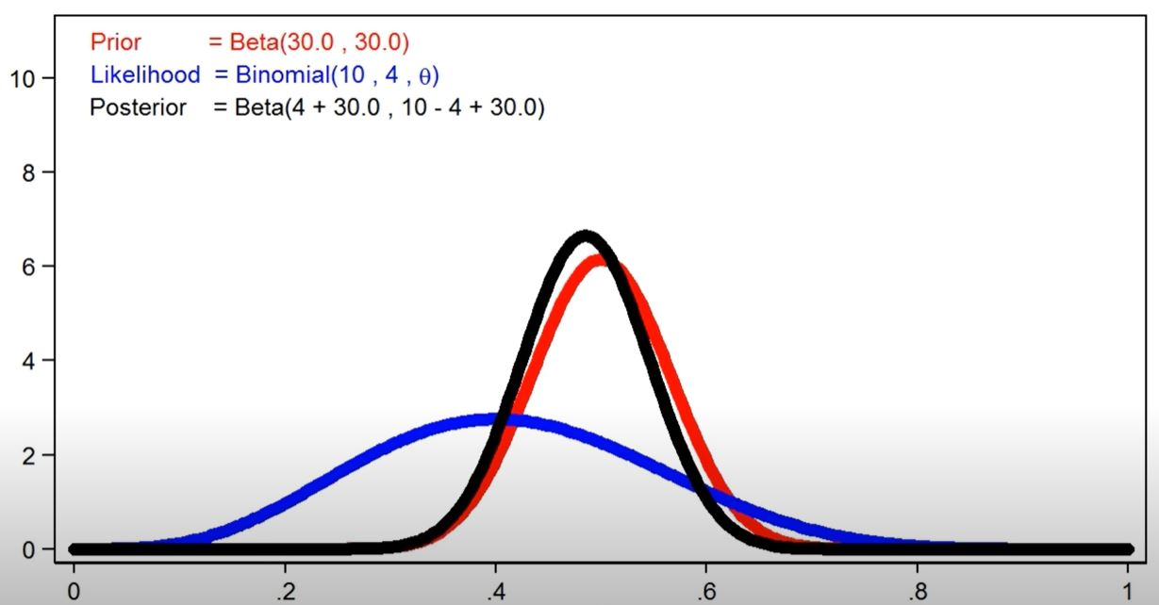
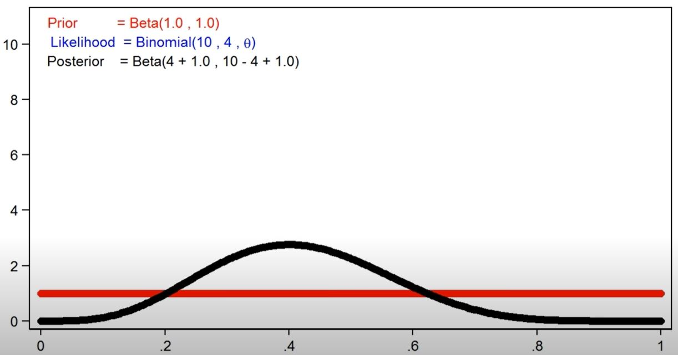
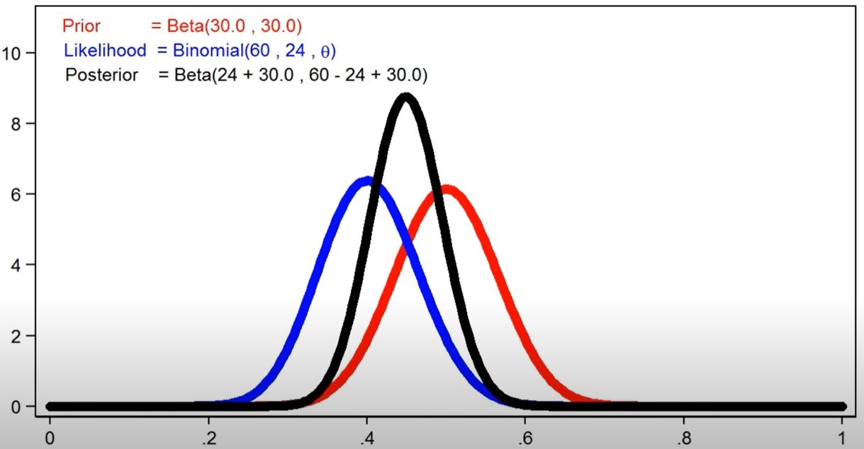
Relationships between distributions:
Figure 1.
Visualizations in changes in the posterior distribution as the result of different prior and likelihood strengths²
a. Strong informative prior, weak evidence
b. Uniform prior, weak evidence
c. Strong prior and strong evidence
²StataCorp (2016, 3:00)
Notes:
So each of the three elements are represented as probability distributions. And these are some examples that outline the relationships. It’s clear that the posterior (in black) changes shape depending on the relative strengths of our prior belief and the data that we collect. Here’s what I mean. In graph a., if you use an informative prior, meaning you have a pretty strong sense of what the outcome would look like, your updated belief will not sway too far from your prior belief. On the other hand, when you use a uniform prior, where every outcome is equally likely, your updated belief will just be exactly the same as your data because you had no preference. However, this type of prior would be avoided in research because even when you don’t really know what the result would be, intuitively you have a sense of which effects are just too extreme to be probable.
Uniform priors are actually used quite a lot in practice. Usually when you collect a ton of data, your prior ends up not mattering as much anymore. There’s been arguments that statistically, a uniform prior doesn’t make much sense. And there are some proposed solutions such as using a hierarchical model where we also learn the prior as well as the parameters. But the takeaway is just that the prior is important, but not so much if you have a lot of data. And uniform priors probably don’t make sense unless you really know nothing about the target domain, but they are widely used.

Slide 7
Understanding check
What do you think is one reasonable alternative to a uniform prior?

Slide 8
Bayesian and Frequentist Comparison Table
Bayesian and Frequentist Comparison Table
 | Frequentist | Bayesian
Probability | Long-run frequency | Degree of certainty
Inquiry | What is the probability of the data, given the hypothesis? | What is the probability of the hypothesis, given the data?
Hypothesis testing | Asymmetry of null hypothesis testing | Odds for and against null hypothesis
Result | P-value | Full probability distribution model
Intervals | Confidence intervals | Credible intervals
Notes:
Next, we’re going to discuss some of the big differences between traditional frequentist testing and Bayesian inference:
Firstly, the concept of probability is defined differently. For frequentists, they see probability as a long-run frequency, and that there is one, true parameter value out there in the world which we can estimate through repeated sampling. On the other hand, Bayesians think of the parameter value as an abstraction, a random variable that is distributed where we can be more certain in some values over others.
2. And this connects with the next point, which is the difference in the question that they ask. While frequentists hold the parameter value as fixed and see the data as random, for Bayesians it’s the inverse, and that only the data in front of you is real and fixed.
3. As for hypothesis testing, there's a longstanding criticism of the asymmetry of null hypothesis testing, where you can never state positive evidence in favor of the null, and essentially the imbalance makes it easier to reject the null when there isn’t substantial evidence against it. Meanwhile, Bayesian analysis provides concrete probabilities for each hypothesis or model that you have, which you can then use for comparisons. And this is something Rebekah will touch on in a bit.
4. Lastly, a very important distinction that we must make is between the concepts of confidence, and credible intervals (continue to next slide)

Slide 9
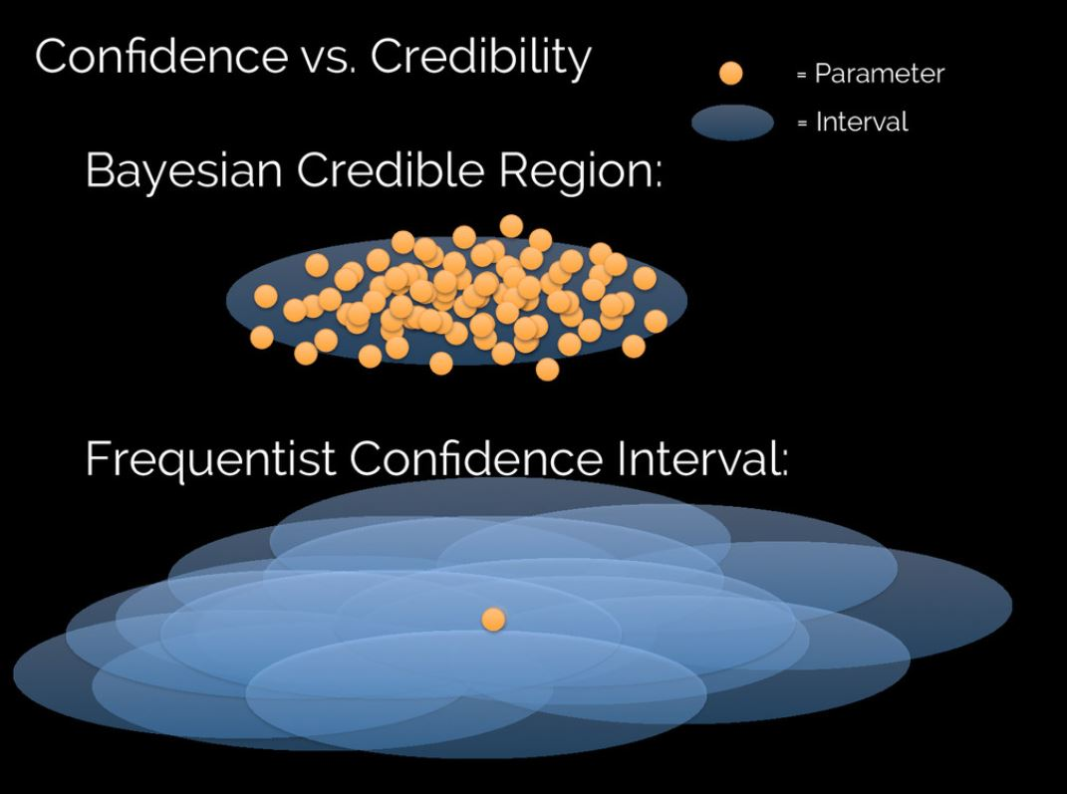
Credible vs. Confidence Intervals
Figure 2. Visualization of the conceptual difference between NHST confidence and Bayesian credible intervals³
³VanderPlas (2014, slide 58)
Notes:
So this is a cool figure to visualize the conceptual difference. On the top, we have the credible interval, which estimates a range of possible effects within one fixed interval, thus we can say we are 95% certain that the true effect is somewhere within this specific interval. Meanwhile, frequentists would have to engage in a sort of backwards reasoning by generating a number of intervals through repeated sampling and claim that 95% of these samples will have contained the one true, fixed parameter value. And so, Bayesian analysis makes the more straightforward probabilistic claim about an effect which frequentists cannot make.

Slide 10
Understanding check
Find an 80% credible and confidence interval for diseases based on first symptom. (Parameter = Disease, Data = Symptom)
Normalized based on disease (columns add up to 100%)
 | Cold | Flu | Food Poisoning | Malaria
Fever | 10% | 80% | 10% | 38%
Headache | 68% | 10% | 10% | 12%
Joint Pain | 18% | 10% | 20% | 50%
Nausea | 4% | 0% | 60% | 0%
Normalized based on symptom (rows add up to 100%)
 | Cold | Flu | Food Poisoning | Malaria
Fever | 7% | 58% | 7% | 28%
Headache | 68% | 10% | 10% | 12%
Joint Pain | 18% | 10% | 20% | 51%
Nausea | 6% | 0% | 94% | 0%

Slide 11
Understanding check
Confidence interval: Hold parameter constant, vary data
Normalized based on disease (columns add up to 100%)
 | Cold | Flu | Food Poisoning | Malaria
Fever | 10% | 80% | 10% | 38%
Headache | 68% | 10% | 10% | 12%
Joint Pain | 18% | 10% | 20% | 50%
Nausea | 4% | 0% | 60% | 0%
Fever -> {Flu, Malaria}
Headache -> {Cold}
Joint Pain -> {Cold, Food Poisoning, Malaria}
Nausea -> {Food Poisoning}

Slide 12
Understanding check
Credible interval: Hold data constant, vary parameter
Normalized based on symptom (rows add up to 100%)
 | Cold | Flu | Food Poisoning | Malaria
Fever | 7% | 58% | 7% | 28%
Headache | 68% | 10% | 10% | 12%
Joint Pain | 18% | 10% | 20% | 51%
Nausea | 6% | 0% | 94% | 0%
Fever -> {Flu, Malaria}
Headache -> {Cold, Malaria}
Joint Pain -> {Flu, Food Poisoning, Malaria}
Nausea -> {Food Poisoning}

